Slide 1
How to register to the NHS App Part 1 : Registering your account Part 2: Confirming your identity
This Photo by Unknown Author is licensed under CC BY-SA

Slide 2
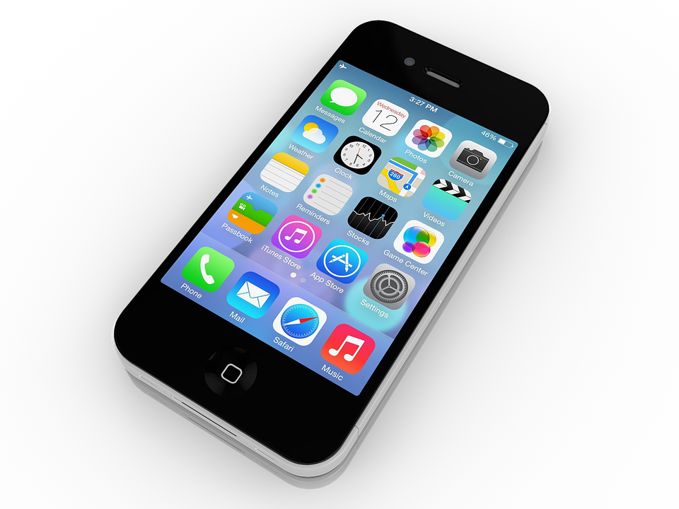
Why you should register to the NHS App?
Book
Book appointments with your GP
Order
Order repeat prescriptions
Check
Check symptoms with online symptom checker
Find out
Find out when you need help urgently
View
View your GP medical record securely
Register
Register to be an organ donor
Choose
Choose how the NHS uses your data

Slide 3
Part 1: Registering your account

Slide 5
Slide Title
1
2
3
4
5
8
7
6
Open your email account and find the email from NHS
9
10
11
12
13
14
15
18
17
16
This Photo by Unknown Author is licensed under CC BY-SA

Slide 6
Congratulations! You have now finished Part 1.
You should now have this page on your screen.
You can now look up:
Advice on health conditions and treatments
Use NHS 111 online for urgent help

Slide 7
To look at your GP record and prescription service, you need to confirm your ID.
To learn how to confirm your ID, please see Part 2.

Slide 8
Part 2: Proving your identity

Slide 9
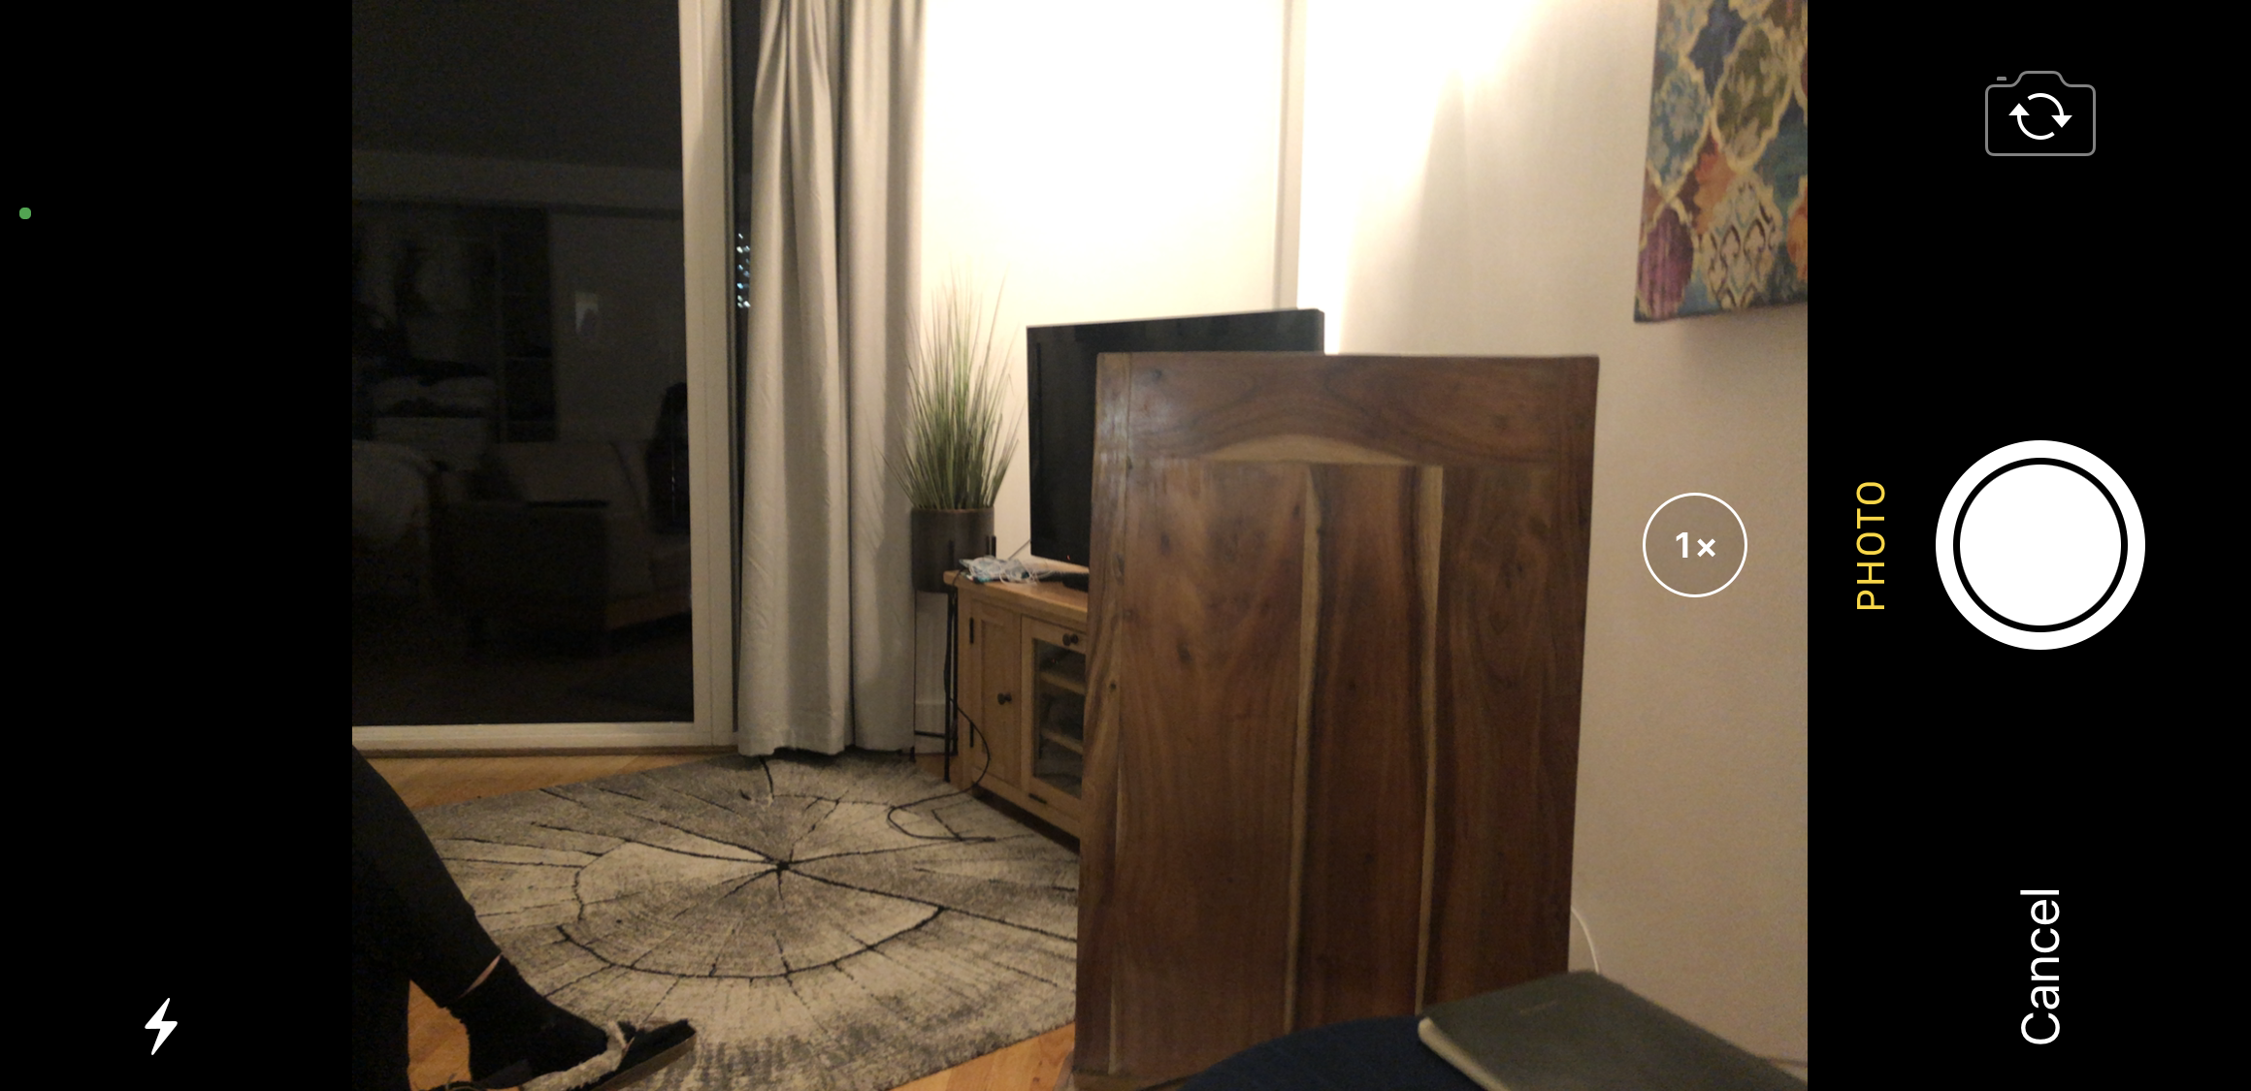
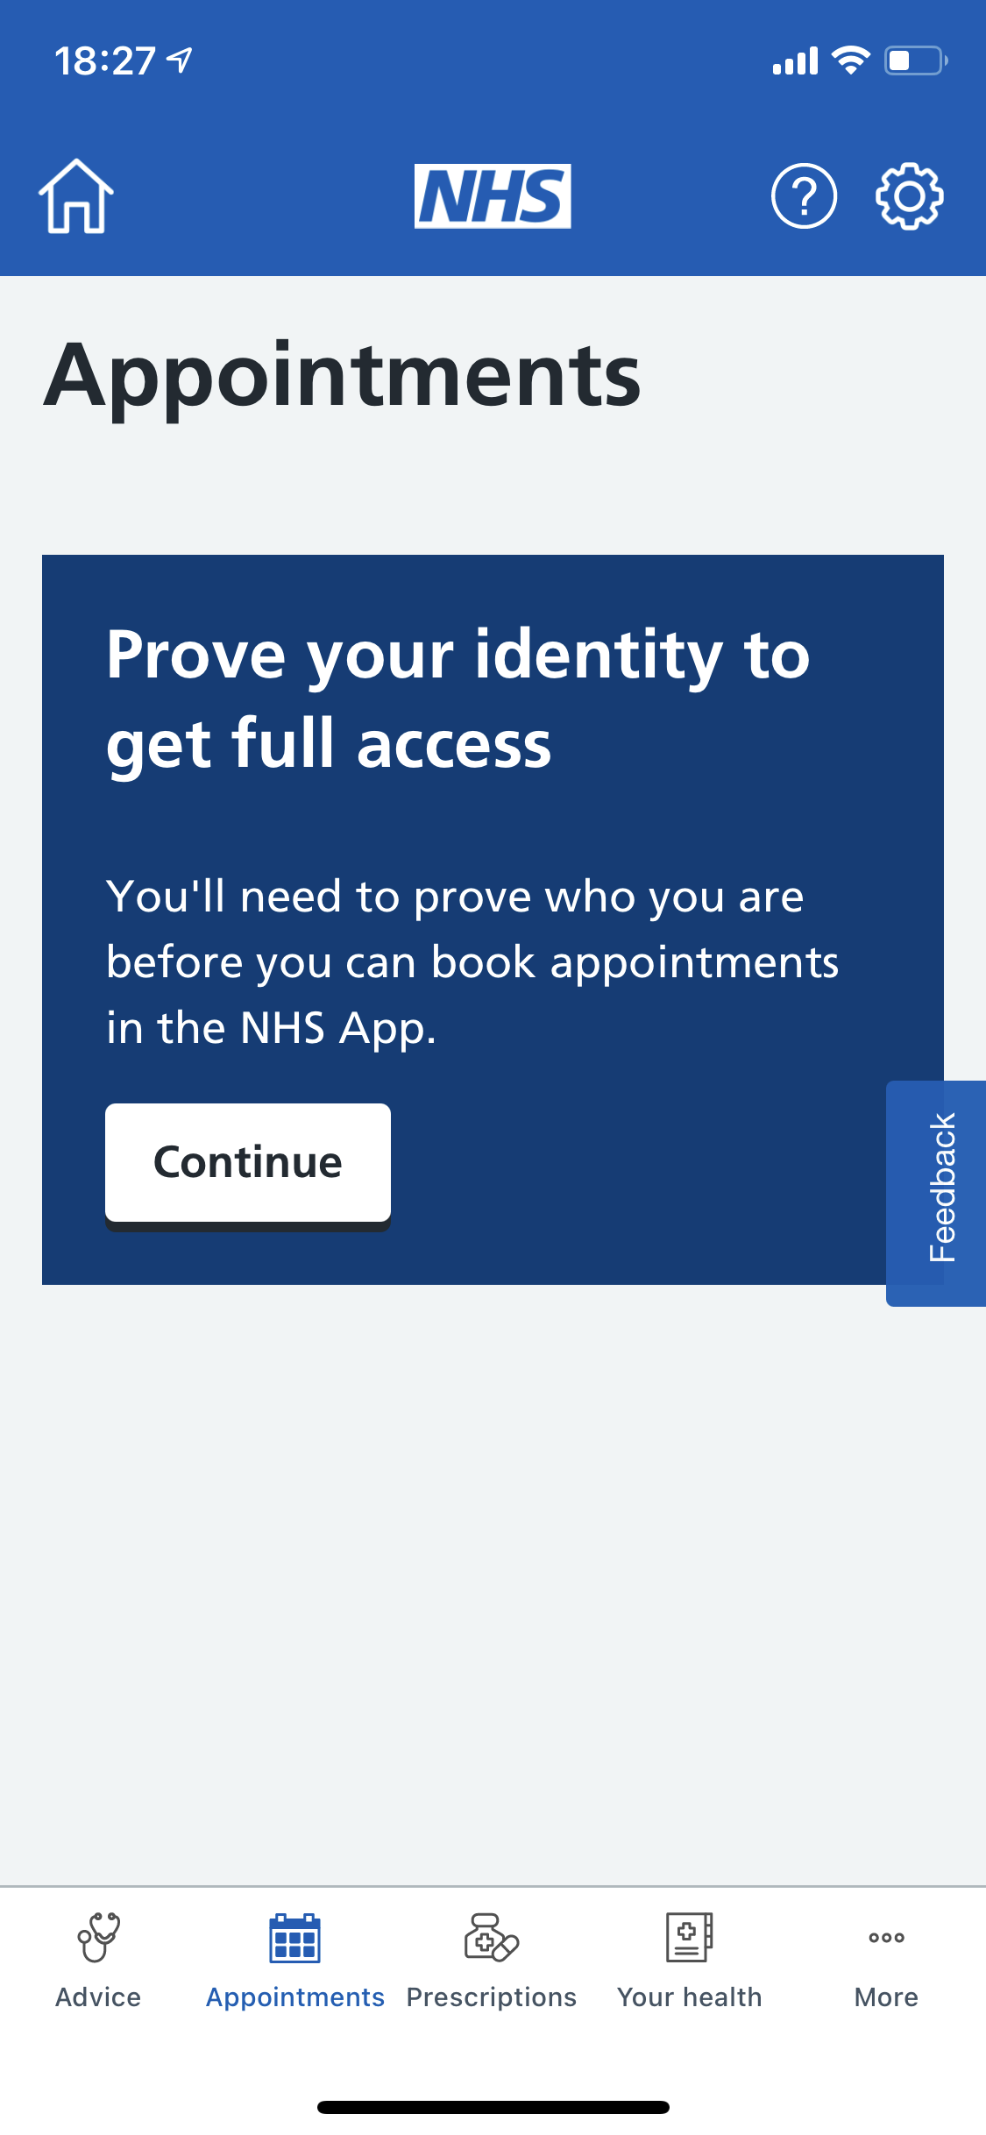
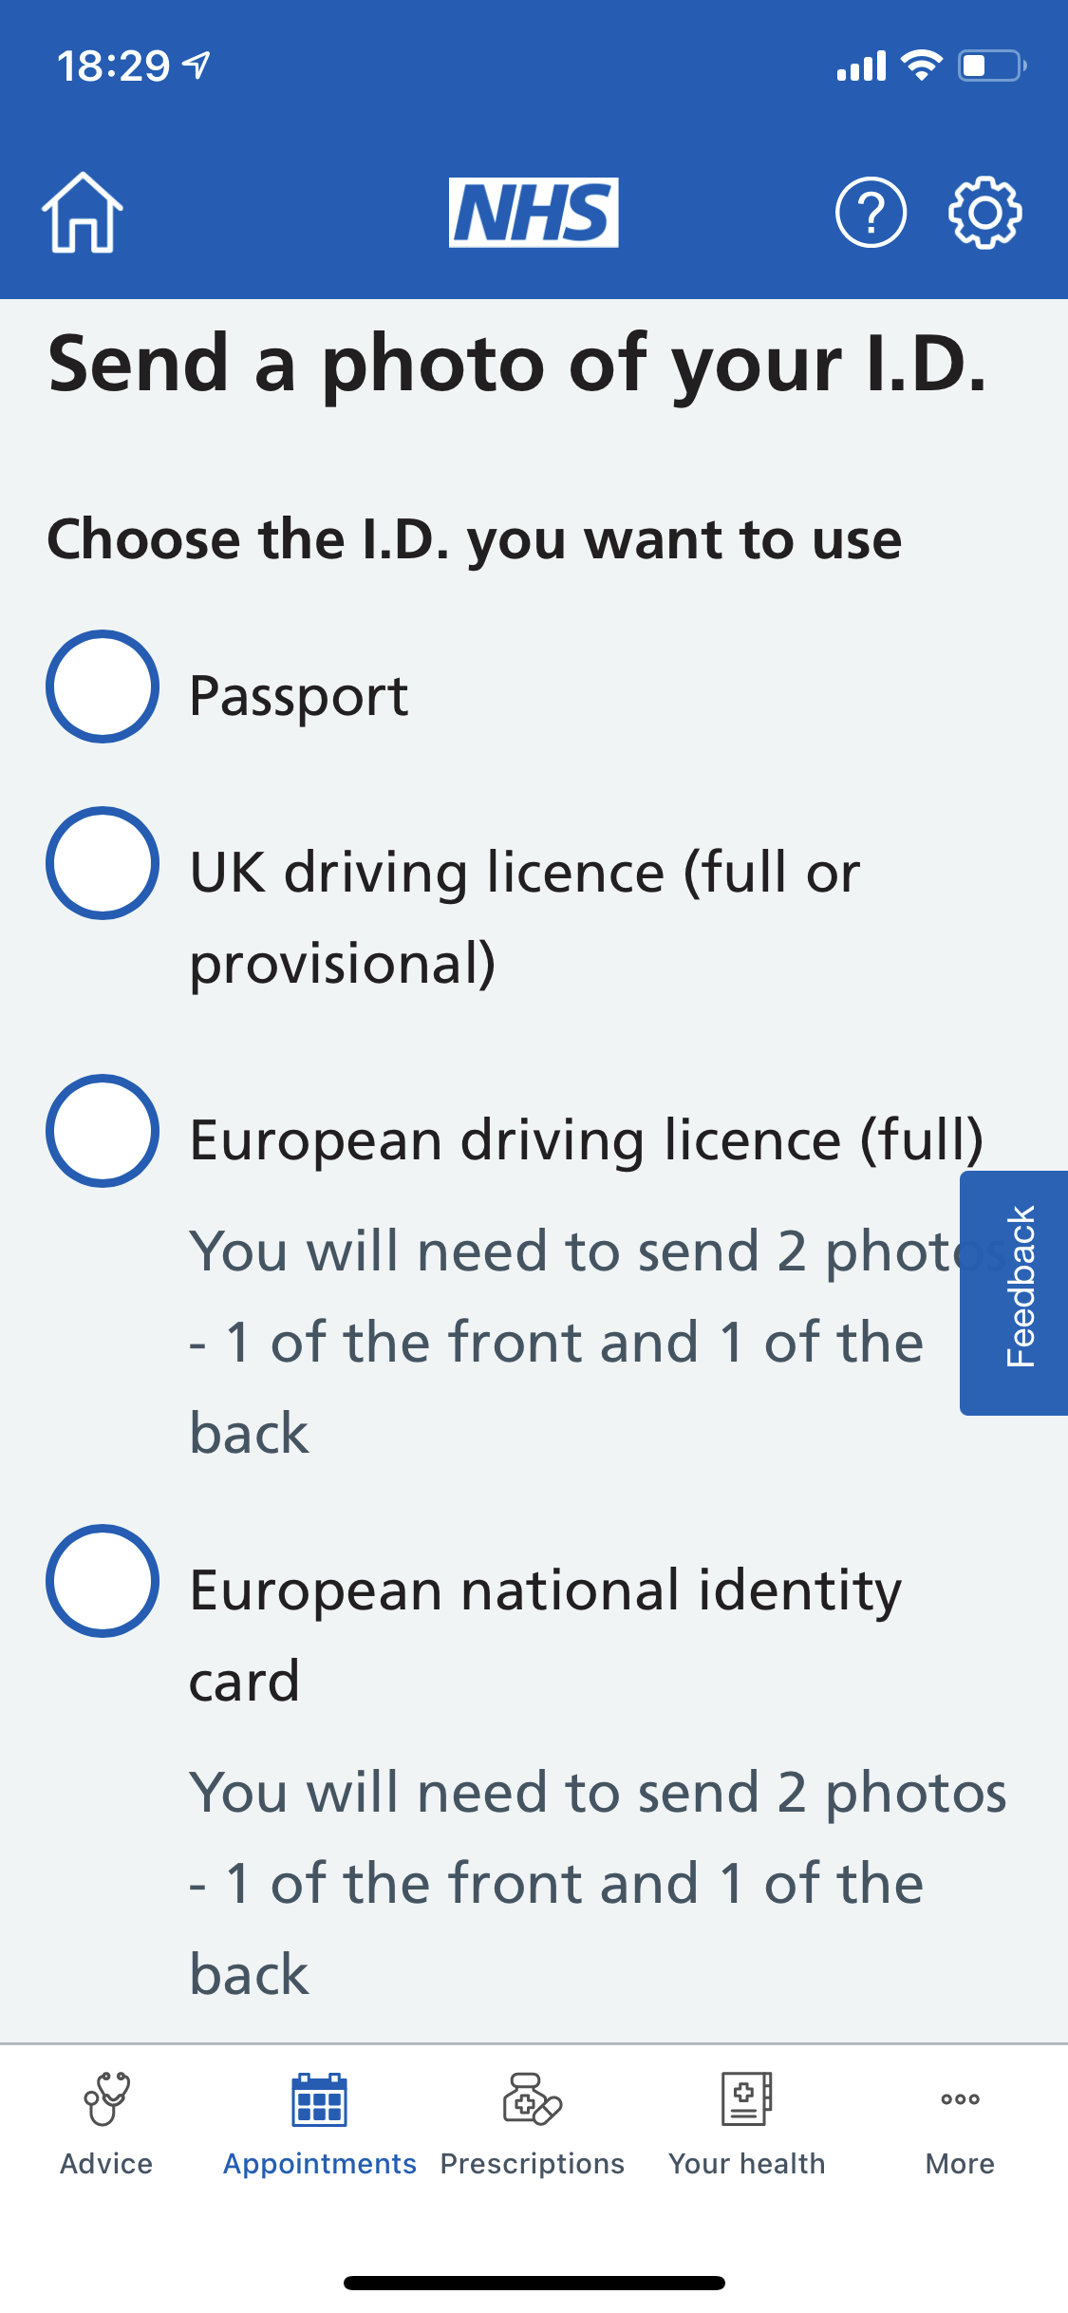
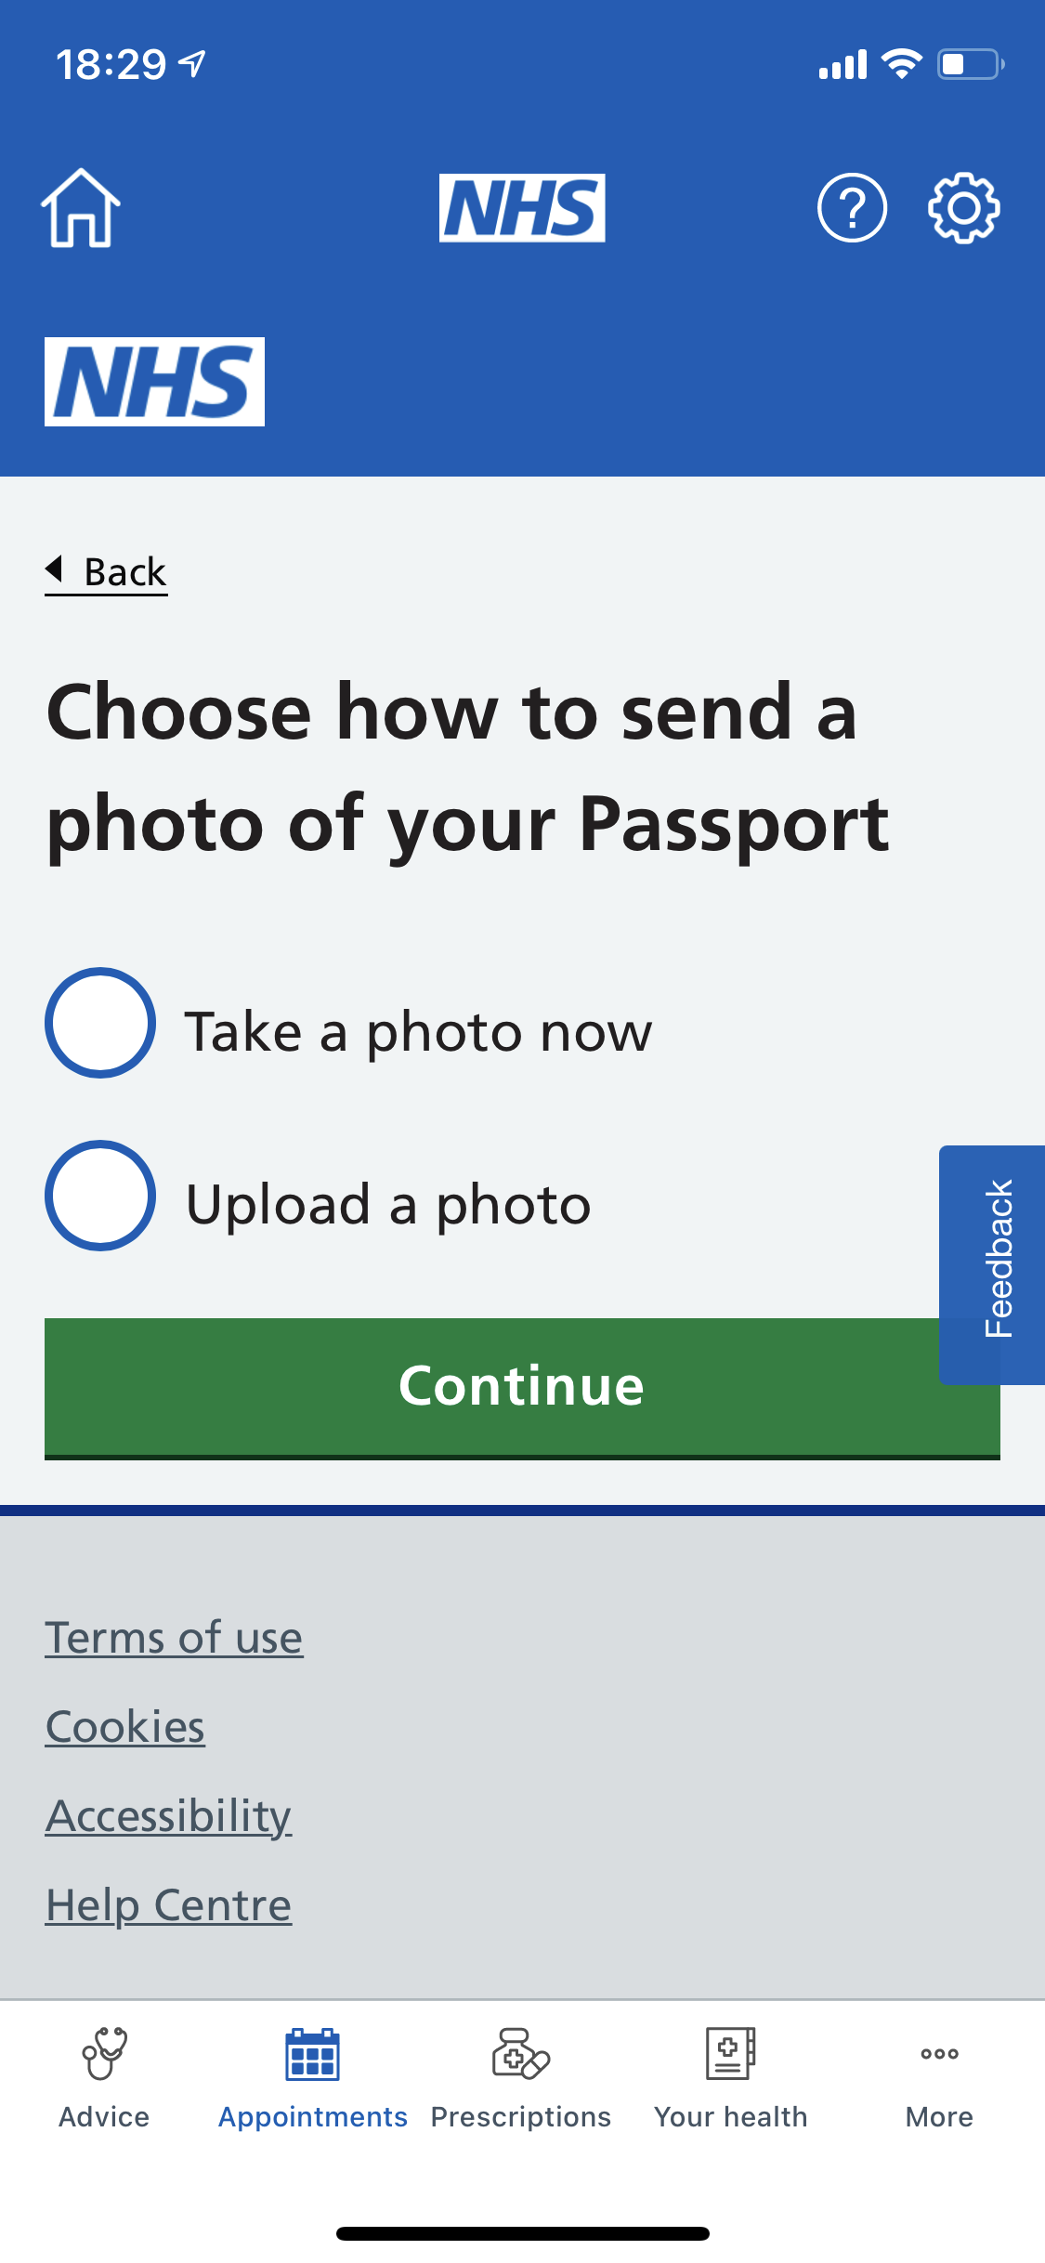
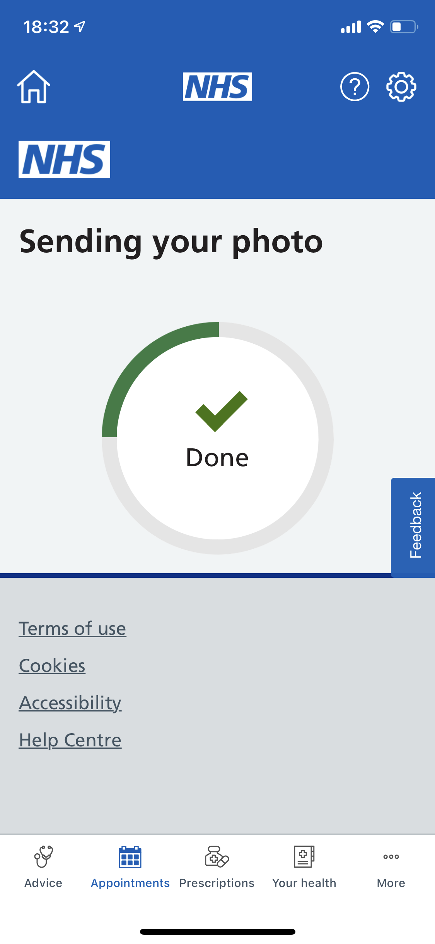
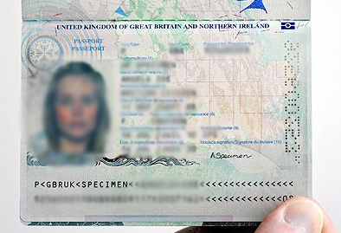
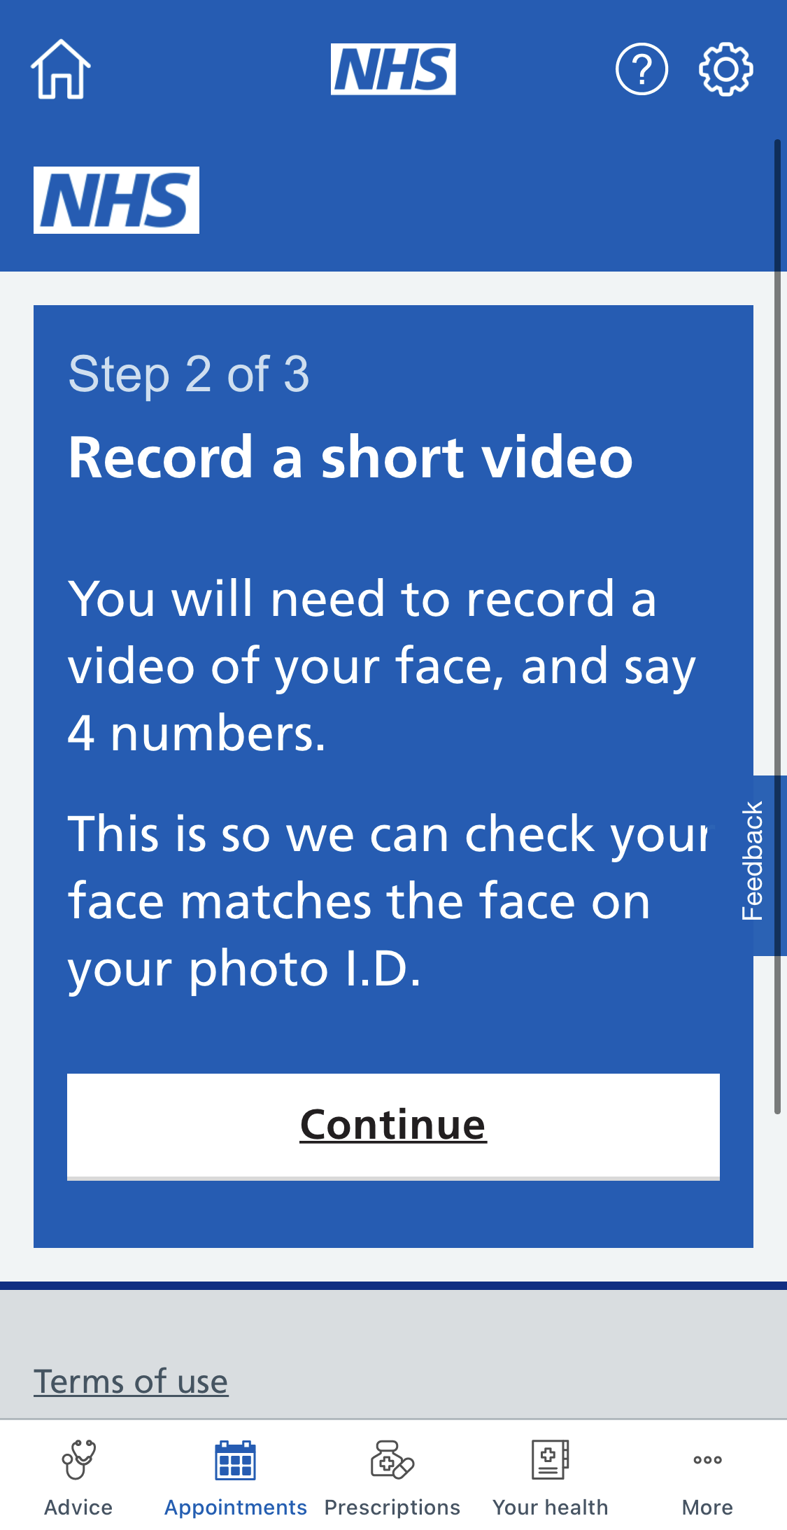
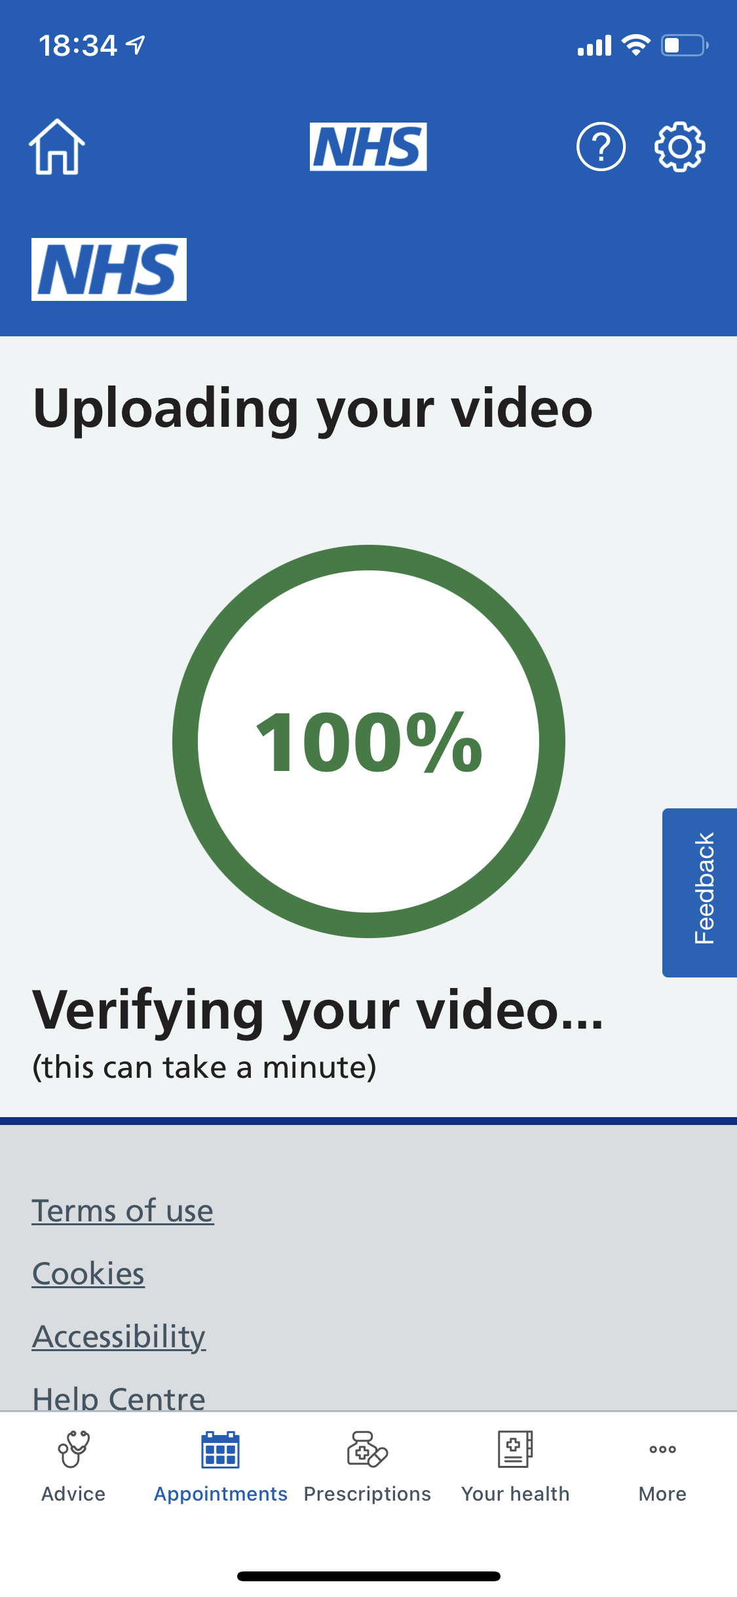
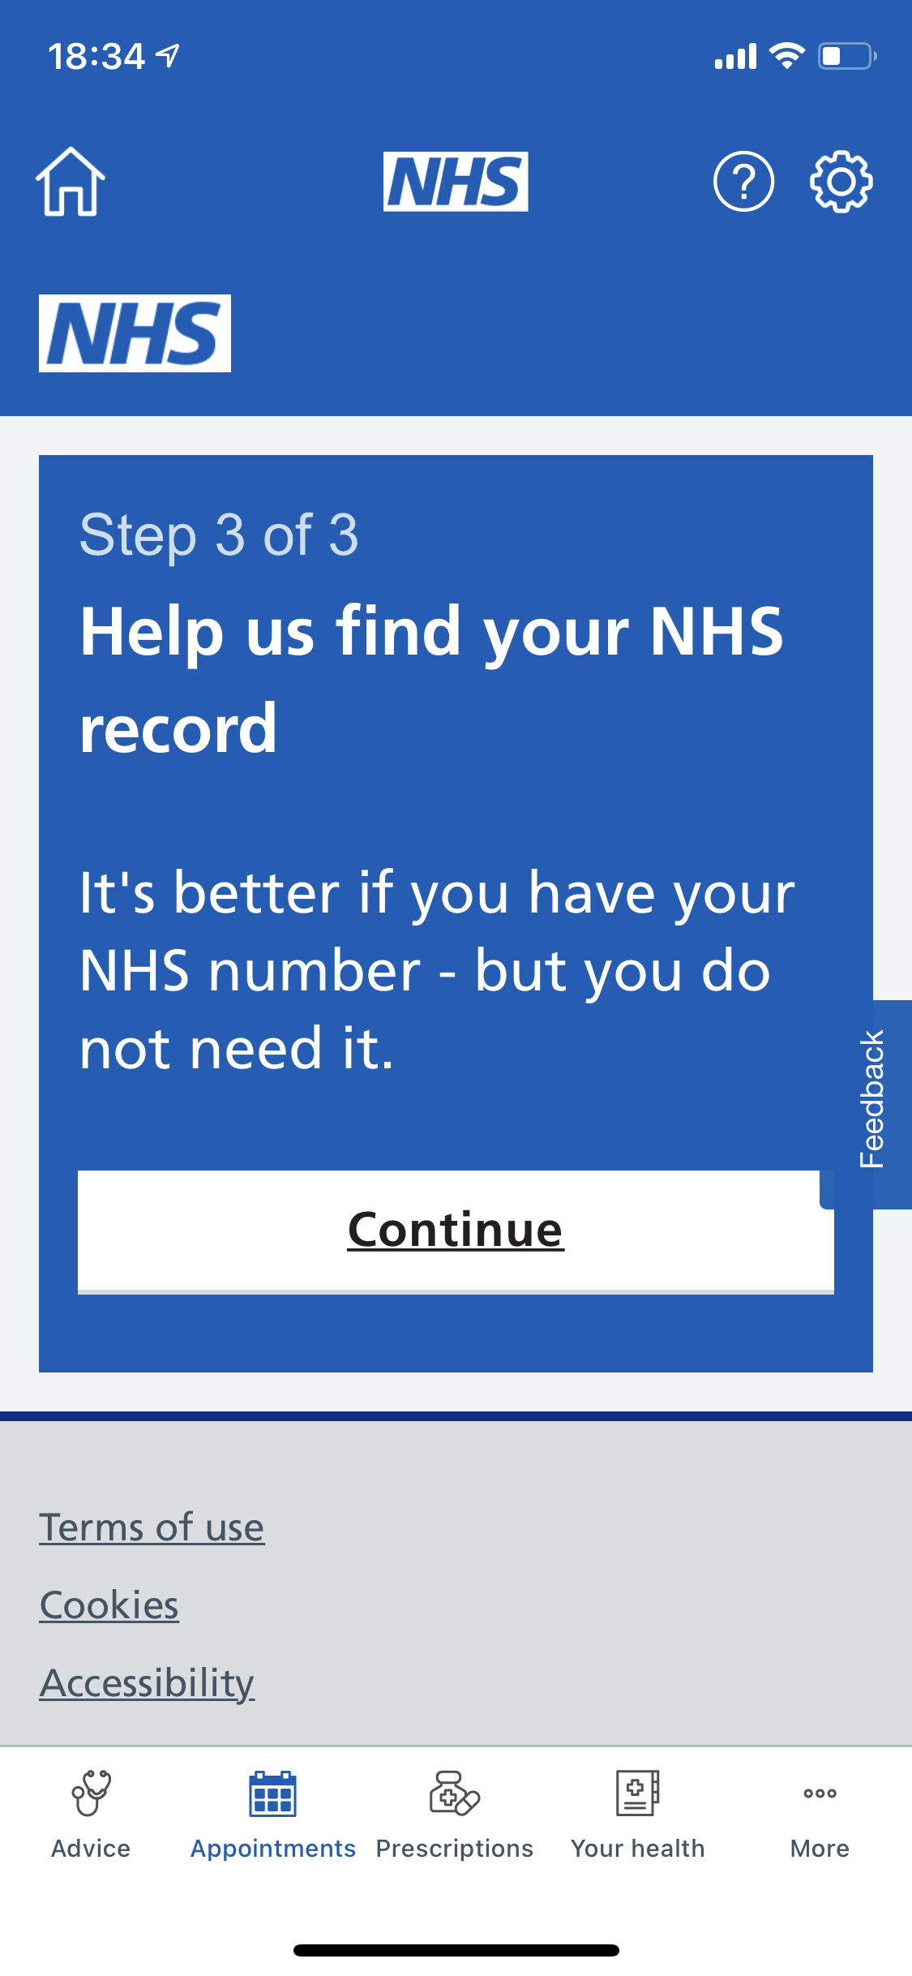
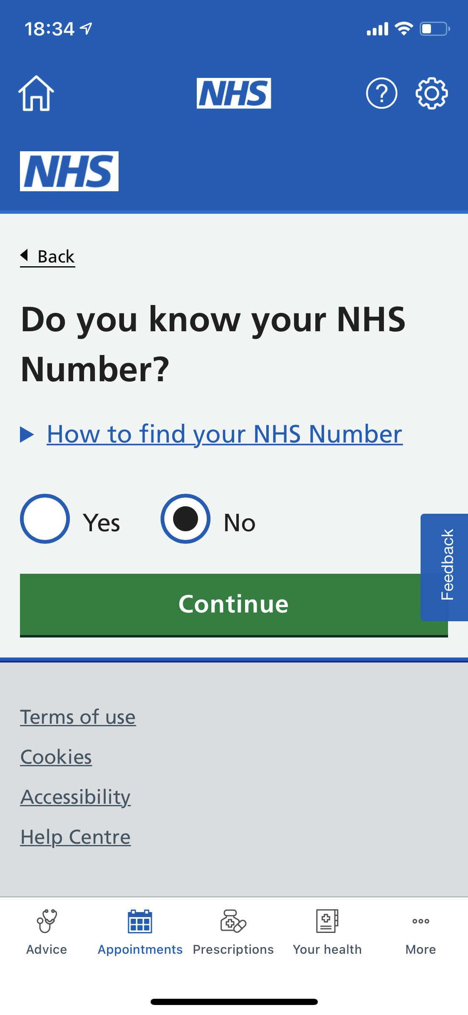
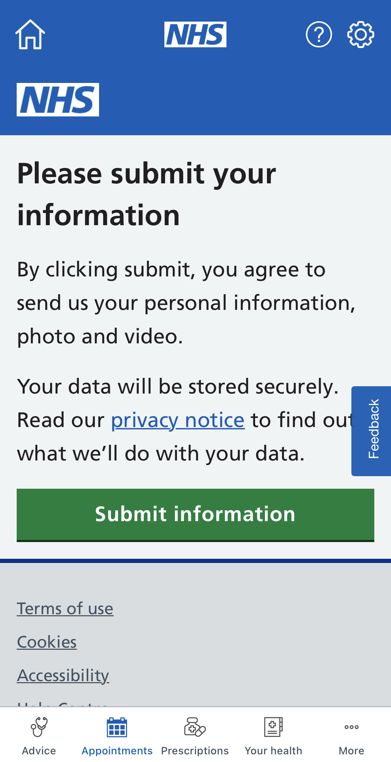
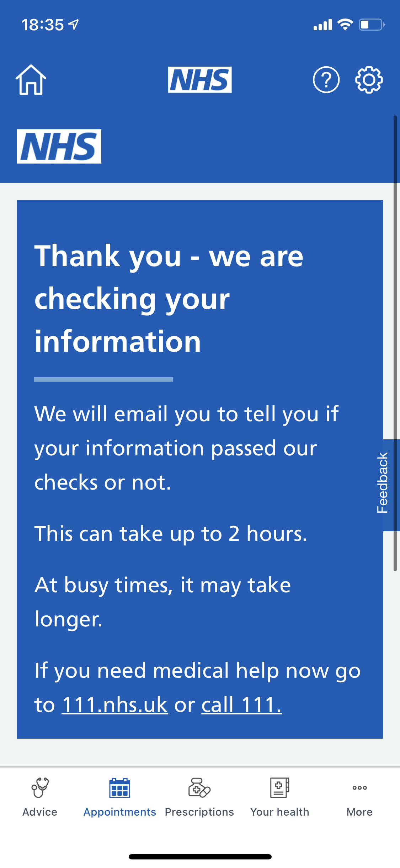
Proving your identity
Once you have successfully registered with the app and logged in, proof of identity will be required to use some of the functions.
How do I do this?
1.
2.
3.
4.
5.
Ensure that the whole page is in view, and all 4 edges line up with the camera frame
On the first page of appointments, press continue
Choose a form of ID
Take a photo of your ID
When you are happy with the photo, press “use photo” and then continue
6.
7.
8.
9.
10.
11.
A photo or video of your face must be submitted too
Once you have taken the photo/video, press “use” and let it upload
In the final step, they may require a bit more information
If you do not have an NHS number, don’t worry, it is not essential - just press “No”
If you are happy with everything, press “submit information”
All done! They will check your information. If they are not happy, they may ask you to repeat the steps

Slide 10
You have now finished Part 1 and Part 2
Once you have passed your ID check you should be able to:
Book GP appointments
Order prescriptions
Look at your medical records

