Slide 1
Employment Support Intervention
Effective CV and Cover Letter Writing, and Practice Interview Questions session
By Fahima Tamanna, Student Occupational Therapist at Sheffield Hallam University.

Slide 2
Introduction
The presentation will explain:​
What is a CV?
Why do we need a CV to apply for a Job?
5 tips of writing a good CV
What things TO DO and NOT TO DO when
writing a CV?
What should be written in a CV?
What is a Covering letter and why is it
needed?
Practice Interview Questions
{Each section will be explained with examples}
By Fahima Tamanna, Student Occupational Therapist at Sheffield Hallam University.

Slide 3
What is a CV (Curriculum Vitae)?
A CV (Curriculum Vitae) is a document that shows your skills, experience, and education. It is needed when you apply for a job.
Your CV helps employers understand why you are the right person for the job. It usually includes:
- Your work experience (past jobs including paid or voluntary jobs)
- Your education and qualifications (schools, courses, degrees, certifications)
- Your skills (things you are good at)
You can also add achievements and hobbies if they are important for the job.
Your CV is one of the first things an employer sees, so it should be clear, well-organised, and professional.
By Fahima Tamanna, Student Occupational Therapist at Sheffield Hallam University.

Slide 4
Why do we need a CV to apply for a Job?
A CV is a document that shows your skills, work experience, and education. It is the first thing an employer sees when you apply for a job. A good CV helps you make a strong first impression and shows why you are a good fit for the job. Since employers look at many CVs, it's important to create a CV that is clear and easy to read.
By Fahima Tamanna, Student Occupational Therapist at Sheffield Hallam University.

Slide 5
Employment process
1) Research Job opportunities:
Look for jobs that interest you and match your skills.
2) Write a covering letter:
Prepare a short letter explaining why you are the right person for the job.
3) Create a CV:
Fill out your CV with your work experience, skills, and education & qualifications.
4) Attend an interview:
Meet with the employer to discuss your skills and experience.
5
By Fahima Tamanna, Student Occupational Therapist at Sheffield Hallam University.

Slide 6
5 tips of writing a good CV 1) Clear - well organised and logical 2) Concise - relevant and necessary 3) Complete - includes everything you need 4) Consistent - don't mix styles or fonts 5) Current - Up-to-date
By Fahima Tamanna, Student Occupational Therapist at Sheffield Hallam University.

Slide 7
What things TO DO and NOT TO DO when writing a CV?
TO DO:
• Use a standard font size in.
• Include recent and relevant work experience (paid or voluntary).
• Be consistent in your layout.
• List your skills and achievements and back up with evidence.
• Keep it short (maximum 2 pages).
•Proof-read for spelling, punctuation, grammar and meaning.
• Get someone to check it for you.
NOT TO DO:
• Do it in a rush.
• Leave gaps in employment.
• Lie.
• Simply write a list of Jobs/Voluntary experiences under work experience (remember you are selling yourself).
• Use flashy or large font (style of writing).
By Fahima Tamanna, Student Occupational Therapist at Sheffield Hallam University.

Slide 8
What to Include in a CV?
Personal Statement –
In this section you need to put all the good positive things about yourself, your skills, and why you are the right person for the job. You can have different personal statements for different jobs that you might apply for, so you may want to save a slightly different CV for each job that you are interested in.
Key Skills – A list of your most important skills related to the job. For example:
Communication
Writing
Creativity
Organisational skills
Motivation
Teamwork
Problem-solving
Leadership skills
By Fahima Tamanna, Student Occupational Therapist at Sheffield Hallam University.

Slide 9
What to Include in a CV?
Education – List the courses, schools, colleges, or universities you have attended. For example, if you are studying ESOL Level 1, 2, or 3 courses, Functional Skills Level 1 or 2 courses, Maths, or Science qualifications, include them in this section.
Spare Time Activities (Hobbies and Interests) (Optional) – You can write about your hobbies if they are related to the job. For example: I enjoy beading, and I want to work as a beading teacher.
References – A letter or email from your recent or past employer saying you are a good worker. For example, they can write that you work hard and do your job well. – contact details of…
Employment History – A list of your past jobs (starting with the most recent). Include:
Job Title
Company Name and Address
Dates Worked
Short description of your job role and duties
Qualifications and Training – Any certificates, courses, or training that relate to the job.
By Fahima Tamanna, Student Occupational Therapist at Sheffield Hallam University.

Slide 10
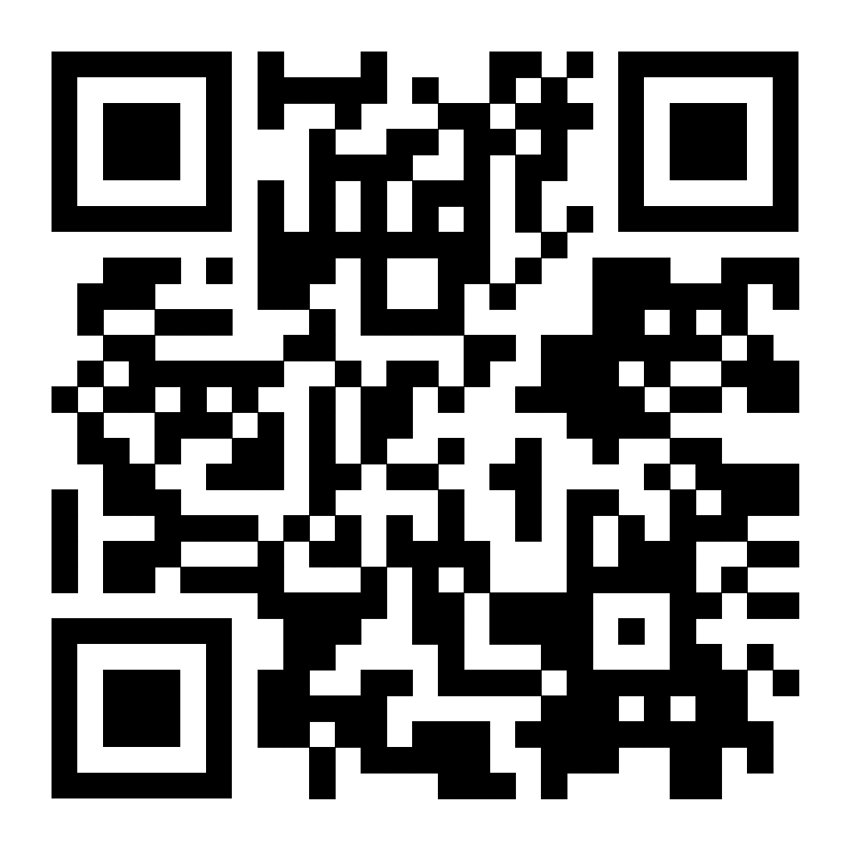
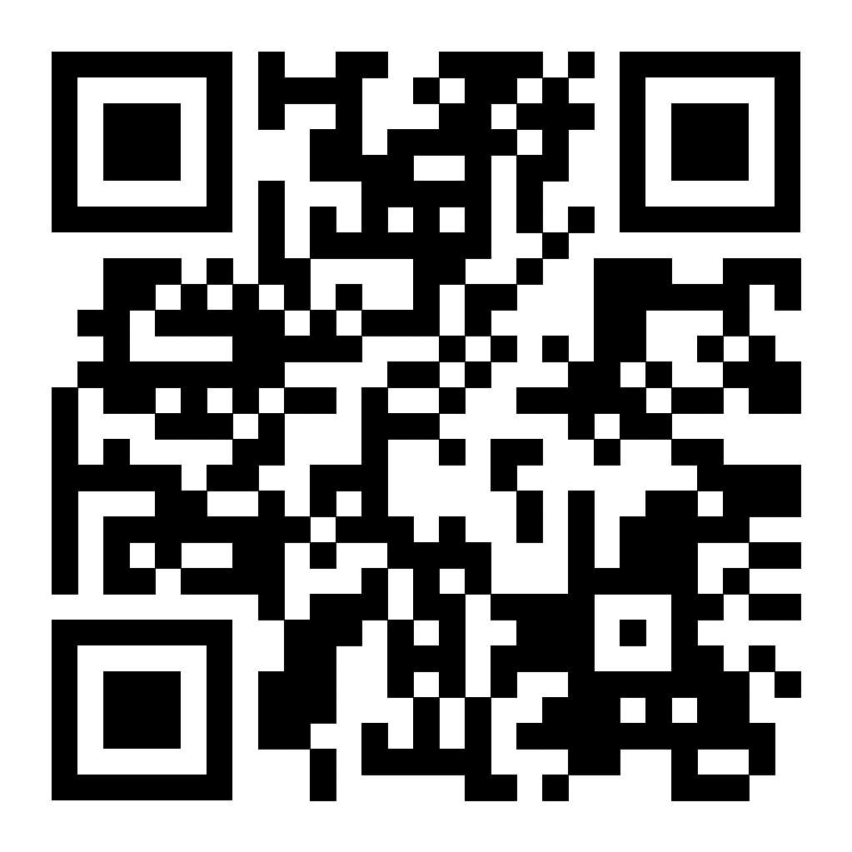
CV writing resources
Example of a CV:
https://www.reed.co.uk/career-advice/free-cv-template/#dataCaptureForm536720
Here is a CV template you can use: https://devoncc.sharepoint.com/:w:/s/PublicDocs/Corporate/ERzjh_kXKiRJn82jOMFSCwkB2HUPh1ys74nRYuslhDCPQw?e=AJ72oZ
By Fahima Tamanna, Student Occupational Therapist at Sheffield Hallam University.

Slide 11
What is a Cover Letter or Covering Letter (both have the same meaning)?
A cover letter is a short document you send with your CV when applying for a job. It introduces you to the employer and explains why you are the best person for the job.
Why is a Cover Letter Important?
It helps you stand out by showing your skills and experience that match the job.
It also shows your interest in the company and the role.
It should not repeat your CV but support it.
Most employers expect a cover letter unless they say otherwise.
How to Write a Good Cover Letter?
Structure:
First Paragraph – Say which job you are applying for and where you found it.
Second Paragraph– Show how your skills and experience match the job.
Third Paragraph – Explain why you want the job and how you can help the company.
Last Paragraph – End by expressing interest and asking for an interview.
By Fahima Tamanna, Student Occupational Therapist at Sheffield Hallam University.

Slide 12
How to Address a Cover Letter?
If you know the name, use ‘Dear (Name)’.
If not, use ‘Dear Hiring Manager’.
How to Sign Off a Cover Letter?
If you use a name, end with ‘Yours sincerely’.
If you use a general greeting, end with ‘Yours faithfully’.
Should You Mention a Disability?
This is your choice. If you do, focus on your strengths and how you handle challenges. Employers must provide fair support for disabled employees.
The Equality Act 2010 legally protects people from discrimination in the workplace and in wider society. Under the Equality Act 2010, employers must support disabled employees fairly. This means they must make reasonable adjustments to help employees (working people) do their job, such as changing workspaces, providing special equipment, or offering flexible hours. This ensures everyone has a fair chance at work.
By Fahima Tamanna, Student Occupational Therapist at Sheffield Hallam University.

Slide 13
Tips for a Good Cover Letter
Keep it short (one page, 3-5 paragraphs).
Customize it for each job.
Use keywords from the job description.
Address it to the right person if possible.
Save it as a PDF, unless the employer asks for another format.
If sending by email, write the cover letter in the email body, not as an attachment.
Avoid repeating your CV and keep your letter clear and direct.
A good cover letter increases your chances of getting an interview. Keep it simple, relevant, and professional!
By Fahima Tamanna, Student Occupational Therapist at Sheffield Hallam University.

Slide 14
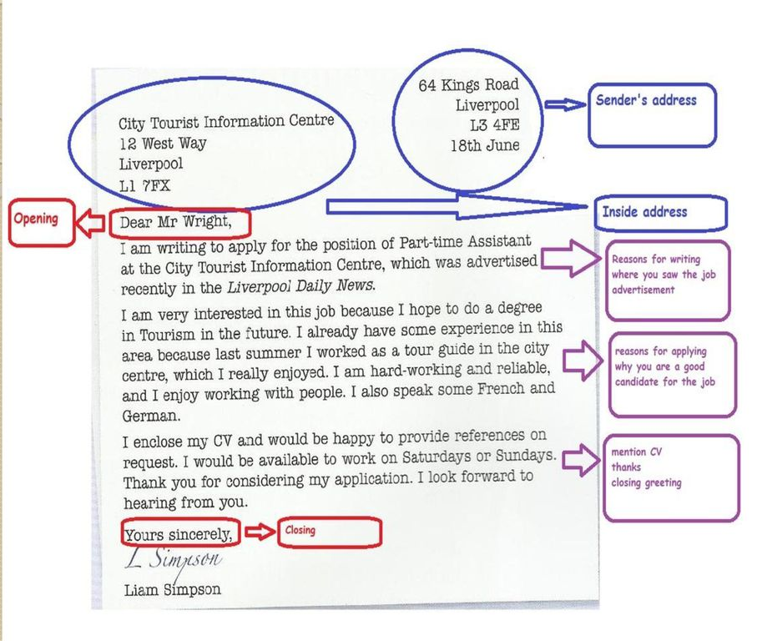
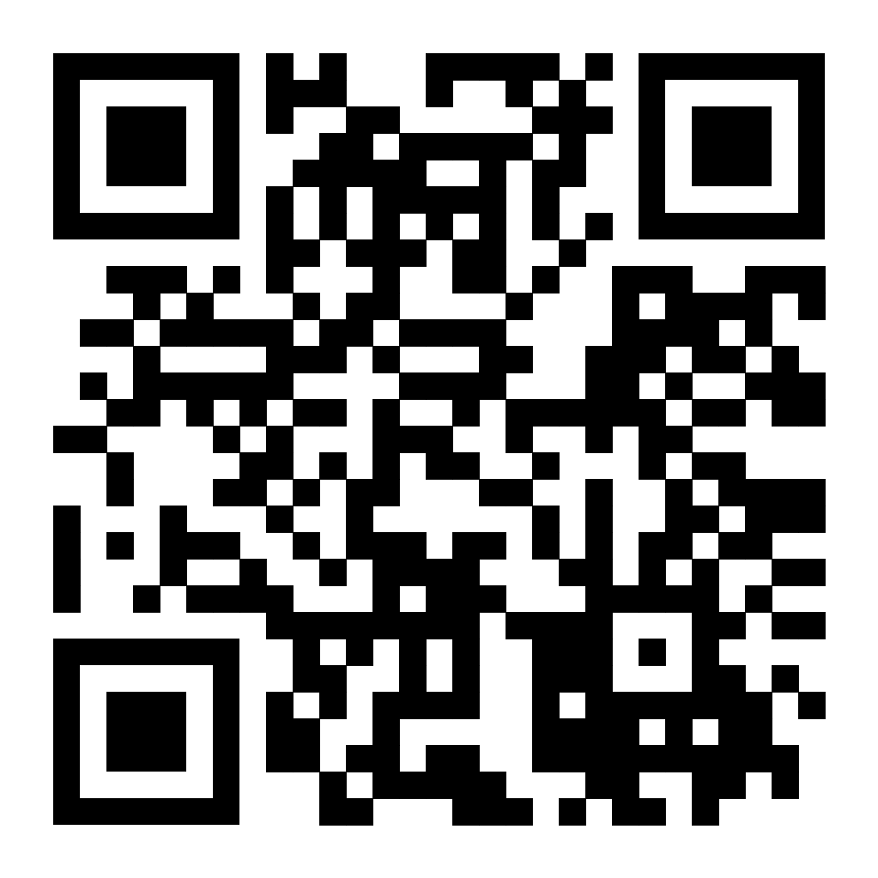
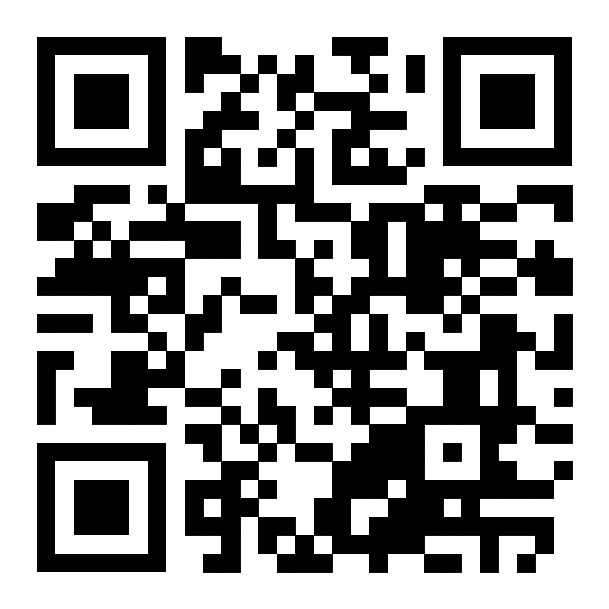
Scan the QR codes to view.
The Prospects Website to help write a Cover letter https://www.prospects.ac.uk/careers-advice/cvs-and-cover-letters/cover-letters/sample-cover-letter
PDF version of Sample Cover letter
By Fahima Tamanna, Student Occupational Therapist at Sheffield Hallam University.

Slide 15
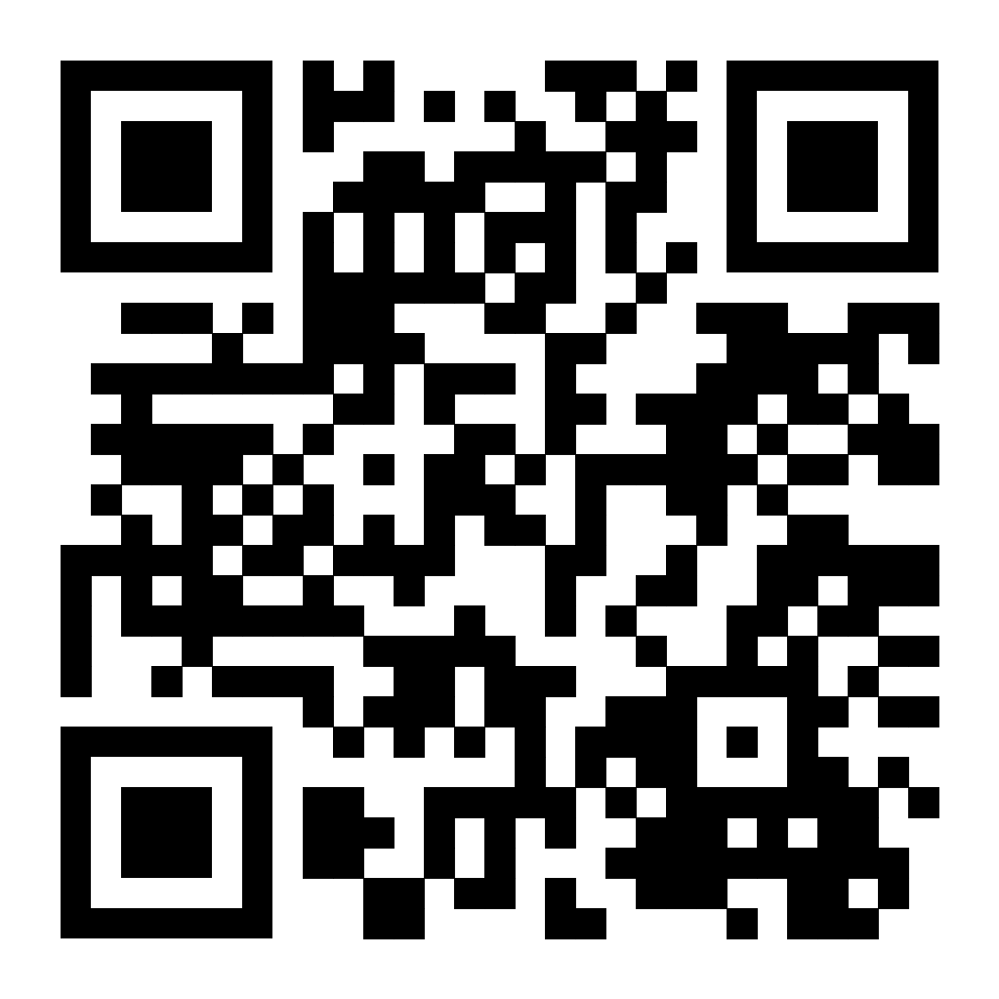
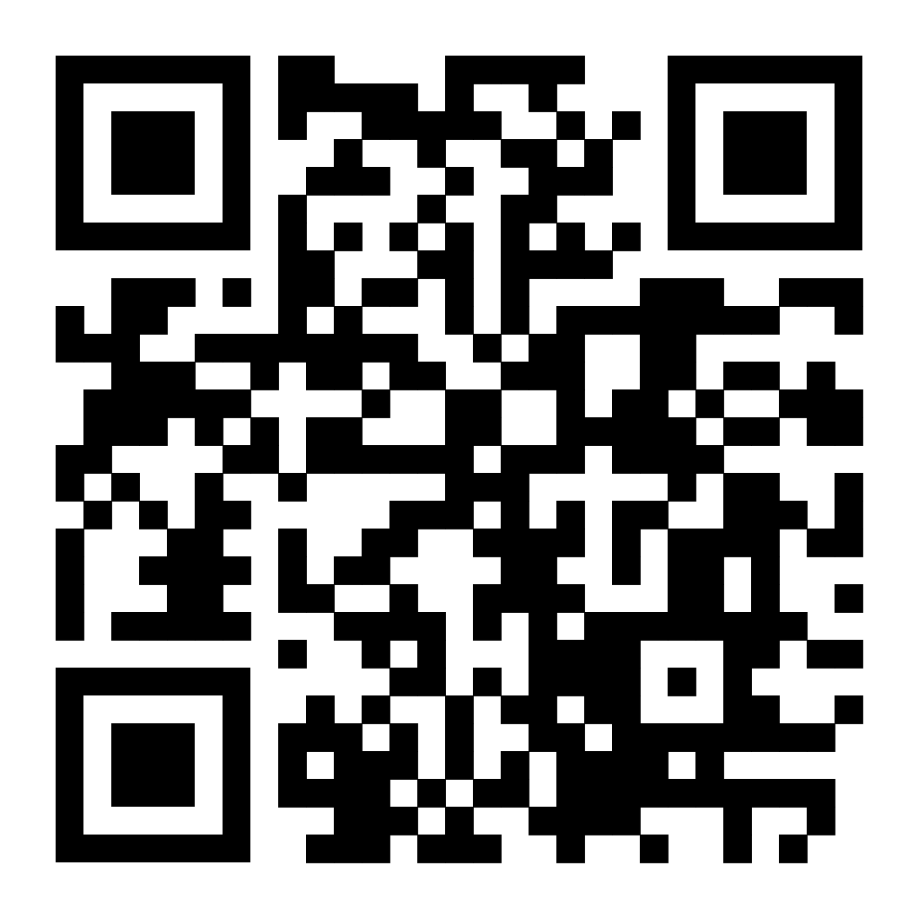
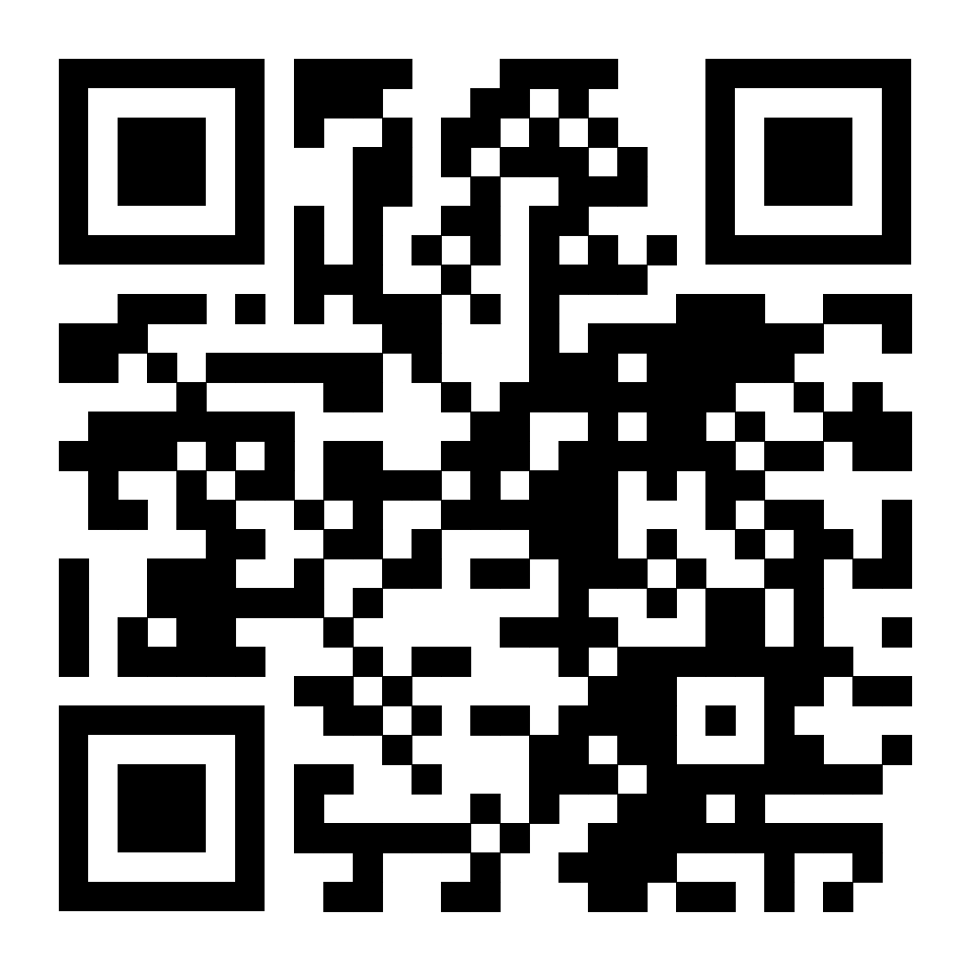
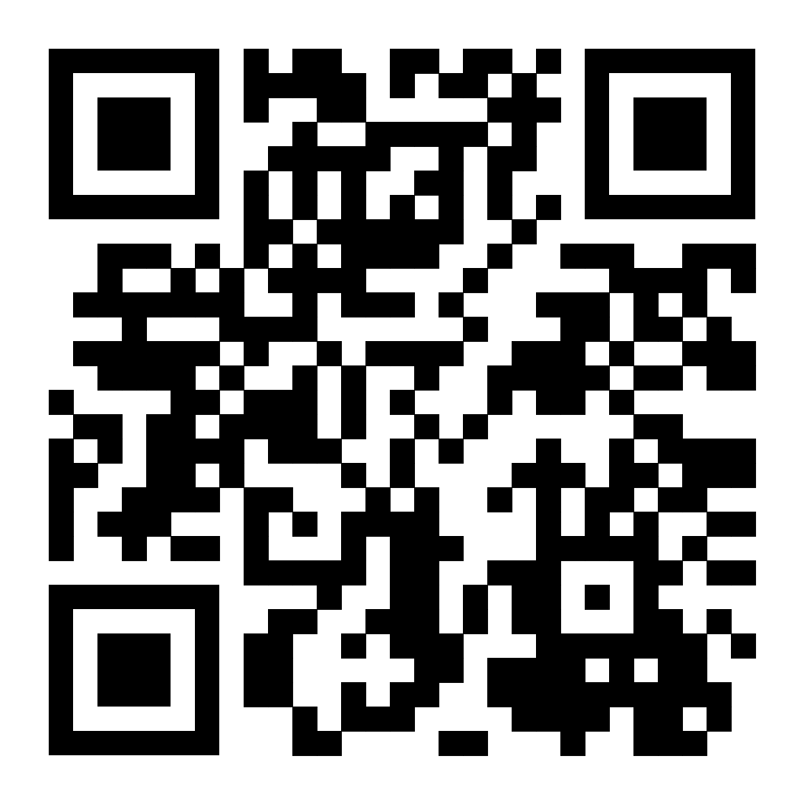
Covering letter writing resources
Scan the QR Codes to access the links.
Explains in detail how to write each section of a covering letter with examples. And it also includes a free template of a Covering letter:
https://www.reed.co.uk/career-advice/free-cover-letter-template/
How to overcome common cover letter problems:
https://www.reed.co.uk/career-advice/how-to-overcome-common-cover-letter-problems/
5 things to NOT DO when writing a covering letter:
https://www.reed.co.uk/career-advice/five-things-you-need-to-stop-doing-on-your-cover-letter/
Advice and guidance for writing a covering letter:
https://devoncc.sharepoint.com/:w:/s/PublicDocs/Corporate/ET7KQYdIOtpIhG2yJdFJ3K4Bg9uNGYy0Fz-VqTdo7Jjb4Q?e=Hf2cua
By Fahima Tamanna, Student Occupational Therapist at Sheffield Hallam University.

Slide 16
Job interviews
What is an Interview?
An interview is a conversation where one person asks questions, and the other answers. It is usually part of the hiring process when applying for a job or university. Interviews help employers find the right person for a job by discussing skills, experience, and personality.
Why Are Interviews Important?
Check if your experience and skills match the job
Learn more about the company and job expectations
Show your personality and how you work with others
Understand what you need to improve
By Fahima Tamanna, Student Occupational Therapist at Sheffield Hallam University.

Slide 17
Common Types of Interviews
1. Based on People Involved:
Personal Interview: One-on-one meeting with a hiring manager
Group Interview: Several candidates discuss a topic together
Panel Interview: A group of interviewers asks questions
2. Based on Structure:
Structured Interview: The interviewer asks fixed questions
Unstructured Interview: A more casual conversation
3. Based on Skills Assessment:
Behavioural Interview: Questions about past experiences
Problem-Solving Interview: Candidates solve a task
Stress Interview: Tests how candidates handle pressure
Other types of interview include:
phone interview
online interview
job fair interview
evaluation interview
promotion interview
persuasive interview
Preparing for different types of interviews helps you feel confident and ready!
By Fahima Tamanna, Student Occupational Therapist at Sheffield Hallam University.

Slide 18
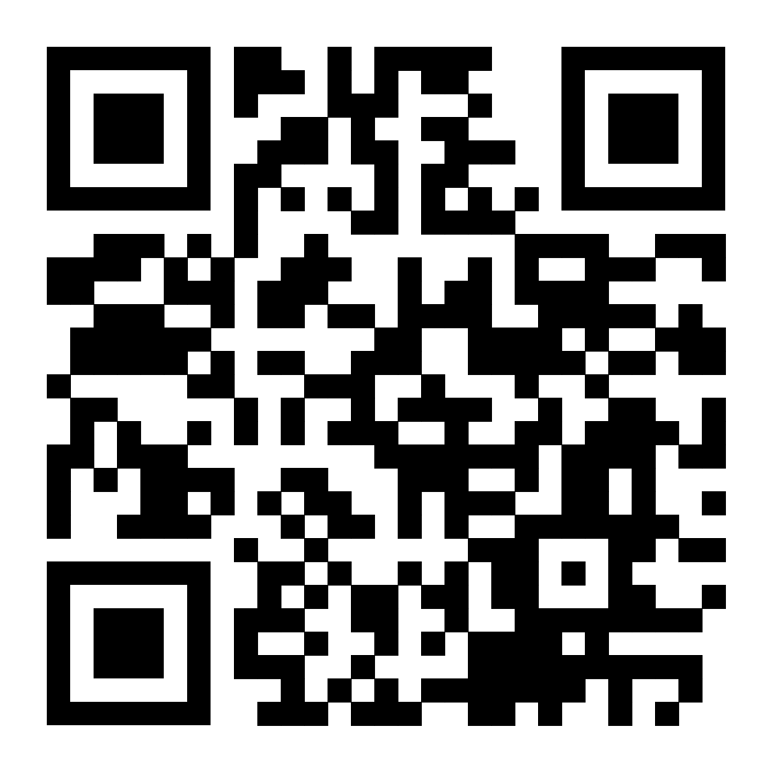
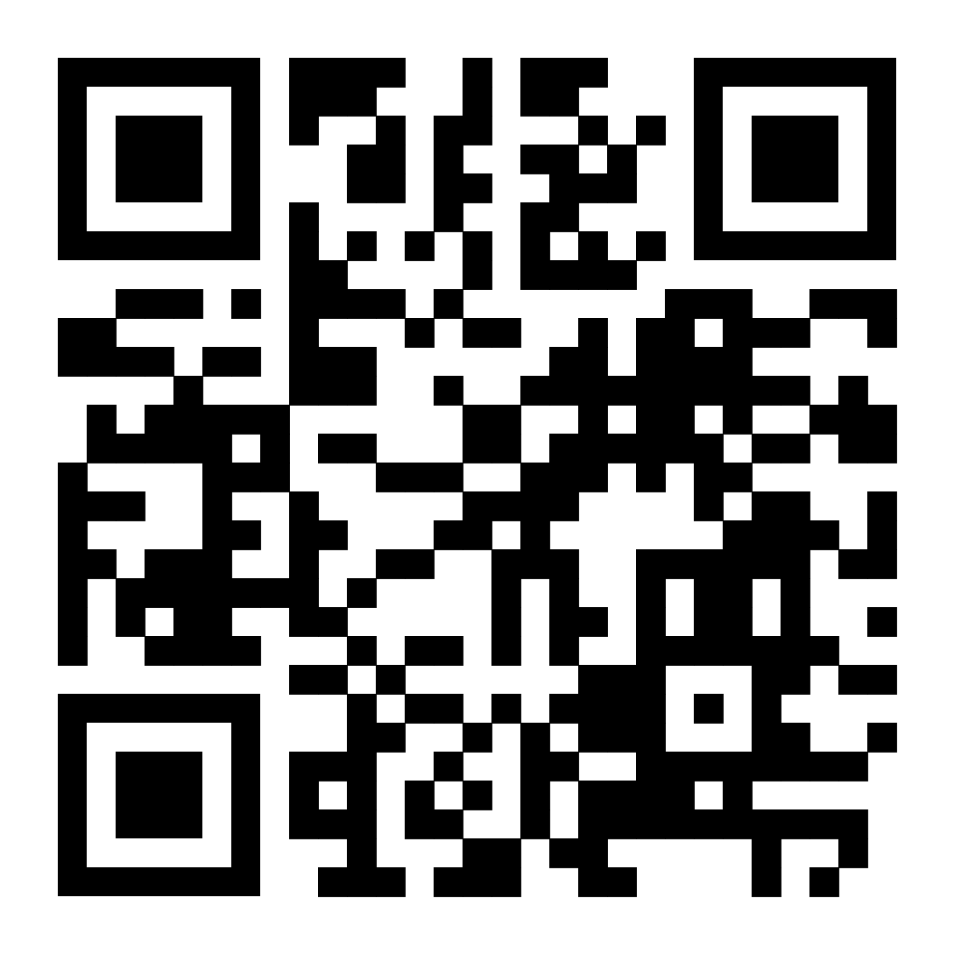
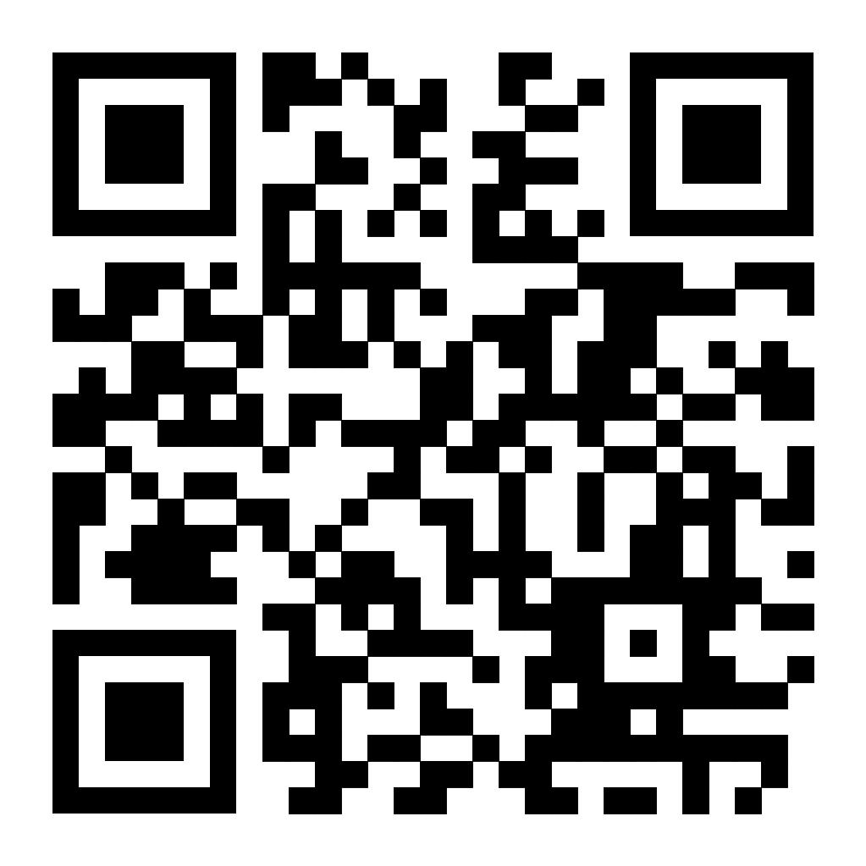
A mock job interview. These are pretend videos for learning purposes.
Scan the QR codes to watch the videos on YouTube.
1)https://www.youtube.com/watch?v=KN2jyw6D1ak&pp=ygUbYmJjIGxlYXJuaW5nIGpvYiBpbnRlcnZpZXdz
2)https://www.youtube.com/watch?v=sj-dX3fZmq0&pp=ygUbYmJjIGxlYXJuaW5nIGpvYiBpbnRlcnZpZXdz
3)https://www.youtube.com/watch?v=NxyUv-viahQ&pp=ygUmdG9wIDIxIGludGVydmlldyBxdWVzdGlvbnMgYW5kIGFuc3dlcnM%3D
By Fahima Tamanna, Student Occupational Therapist at Sheffield Hallam University.

Slide 19
Job interview: Common Interview Questions and Answers
Tell me about yourself. OR How would you describe yourself?
Why do you want to work here?
What motivates you?
How do you handle stress?
What are your goals for the future?
Can you tell me about a time you overcame a difficult work situation?
What interests you about this role?
What are your greatest strengths and weaknesses?
What qualities do you think are needed in this role?
What are your hobbies and interests?
Why do you feel you are the right person for this position?
By Fahima Tamanna, Student Occupational Therapist at Sheffield Hallam University.

Slide 20
Any questions 🙂
Thank you for listening.
By Fahima Tamanna, Student Occupational Therapist at Sheffield Hallam University.

Slide 21
References
Indeed.com: https://uk.indeed.com/career-advice/cvs-cover-letters/curriculum-vitae
Prospects.ac.uk: https://www.prospects.ac.uk/careers-advice/cvs-and-cover-letters/cover-letters
GOV.UK-Equality Act 2010: guidance https://www.gov.uk/guidance/equality-act-2010-guidance
https://www.gov.uk/guidance/equality-act-2010-guidance
Devon County Council: Job application and support (CV Templates) https://www.devon.gov.uk/migration-and-resettlement/key-services/refugee-employment-esol-and-enterprise-project/writing-a-cv/
Reed.co.uk: https://www.reed.co.uk/career-advice/free-cv-template/
Resume Genius: Examples of Cover Letters https://resumegenius.com/blog/cover-letter-help/short-cover-letter-examples
By Fahima Tamanna, Student Occupational Therapist at Sheffield Hallam University.

